Slide 1
Chapter 9: Virtual Memory

Slide 2
Chapter 9: Virtual Memory
Working set
Thrashing
Memory-Mapped Files
Allocating Kernel Memory
Other Considerations

Slide 3
Objectives
To discuss the principle of the working-set model
To examine the relationship between shared memory and memory-mapped files
To explore how kernel memory is managed

Slide 4
Thrashing
If a process does not have “enough” pages, the page-fault rate is very high
  Page fault to get page
  Replace existing frame
  But quickly need replaced frame back
  This leads to:
    Low CPU utilization
    Operating system thinking that it needs to increase the degree of multiprogramming
    Another process added to the system
Thrashing ≡ a process is busy swapping pages in and out

Slide 5
Thrashing
Trashing occurs when a process is busy swapping pages in and out. CPU utilization decreases significantly.
As the # of processes ↑ the # of pages/process ↓ As long as the number of pages per process is large enough to hold the working set then we actually increase CPU utilization without page faulting
As the # of processes ↑↑ the CPU utilization ↓↓ Because the # of pages per process goes below the number required to hold the working set. Each process generates a page fault with almost every instruction
As CPU utilization ↓ a medium level scheduler ↑ # of processes and then CPU utilization ↓↓

Slide 6

Thrashing (Cont.)

Slide 7
Demand Paging and Thrashing
Why does demand paging work?
Locality model
  Process migrates from one locality to another
  Localities may overlap
Why does thrashing occur?
Σ size of locality > total memory size
  Limit effects by using local or priority page replacement
To prevent trashing, we must provide a process with as many frames as it needed
The working-set strategy starts by looking at how many frames a process is actually using
This approach defines the locality model of process execution

Slide 8
Working-Set Model
Working-set model uses a parameter, Δ , to define working-set window ≡ a fixed number of page references
Example: 10,000 instructions
WSS_{i} (working set of Process P_{i}) =
total number of pages referenced in the most recent Δ (varies in time)
  if Δ too small will not encompass entire locality
  if Δ too large will encompass several localities
  if Δ = ∞ ⇒ will encompass entire program

Slide 9
Working-Set Model
D = Σ WSS_{i} ≡ total demand for frames
if D > m (total number of available frames) ⇒ Thrashing
If Δ is selected, use of working set model is simple
  The OS monitors the working set for each process
  If working-set sizes increases, exceeding the total number of available frames, D > m, the OS selects a process to suspend
The working-set strategy prevents trashing while keeping the degree of multiprogramming as high as possible; thus, it optimizes CPU utilization

Slide 10

Working-Set Model

Slide 11
Keeping Track of the Working Set
Approximate with interval timer + a reference bit
Example: Δ = 10,000 references
  Timer interrupts after every 5000 time units
  Keep in memory 2 bits for each page
  Whenever a timer interrupts copy and sets the values of all reference bits to 0
  If one of the bits in memory = 1 ⇒ page in working set
Why is this not completely accurate?
Improvement = 10 bits and interrupt every 1000 time units

Slide 12

Page-Fault Frequency
More direct approach than WSS
Establish “acceptable” page-fault frequency (PFF) rate and use local replacement policy
  If actual rate too low, process loses frame
  If actual rate too high, process gains frame

Slide 13

Working Sets and Page Fault Rates
Direct relationship between working set of a process and its page-fault rate
Working set changes over time
Peaks and valleys over time

Slide 14
Memory-Mapped Files
Memory-mapped file I/O allows file I/O to be treated as routine memory access by mapping a disk block to a page in memory
A file is initially read using demand paging
  A page-sized portion of the file is read from the file system into a physical page
  Subsequent reads/writes to/from the file are treated as ordinary memory accesses
Simplifies and speeds file access by driving file I/O through memory rather than read() and write() system calls
Also allows several processes to map the same file allowing the pages in memory to be shared
But when does written data make it to disk?
  Periodically and / or at file close() time
  For example, when the pager scans for dirty pages

Slide 15

Memory Mapped Files

Slide 16

Shared Memory via Memory-Mapped I/O

Slide 17
Shared Memory in Windows API
First create a file mapping for file to be mapped
  Then establish a view of the mapped file in process’s virtual address space
Consider producer / consumer
  Producer create shared-memory object using memory mapping features
  Open file via CreateFile(), returning a HANDLE
  Create mapping via CreateFileMapping() creating a named shared-memory object
  Create view via MapViewOfFile()
Sample code in Textbook

Slide 18
Allocating Kernel Memory
Treated differently from user memory
Often allocated from a free-memory pool
  Kernel requests memory for structures of varying sizes
  Some kernel memory needs to be contiguous
    I.e. for device I/O

Slide 19
Buddy System
Allocates memory from fixed-size segment consisting of physically-contiguous pages
Memory allocated using power-of-2 allocator
  Satisfies requests in units sized as power of 2
  Request rounded up to next highest power of 2
  When smaller allocation needed than is available, current chunk split into two buddies of next-lower power of 2
    Continue until appropriate sized chunk available
For example, assume 256KB chunk available, kernel requests 21KB
  Split into A_{L} _{and} A_{R} of 128KB each
    One further divided into B_{L} and B_{R} of 64KB
      One further into C_{L} and C_{R} of 32KB each – one used to satisfy request
Advantage – quickly join unused chunks into larger chunk
Disadvantage - fragmentation

Slide 20

Buddy System Allocator

Slide 21
Slab Allocator
Alternate strategy
Slab is one or more physically contiguous pages
Cache consists of one or more slabs
Single cache for each unique kernel data structure
  Each cache filled with objects – instantiations of the data structure
When cache created, filled with objects marked as free
When structures stored, objects marked as used
If slab is full of used objects, next object allocated from empty slab
  If no empty slabs, new slab allocated
Benefits include no fragmentation, fast memory request satisfaction

Slide 22

Slab Allocation

Slide 23
Other Considerations -- Prepaging
Prepaging
  To reduce the large number of page faults that occurs at process startup
  Prepage all or some of the pages a process will need, before they are referenced
  But if prepaged pages are unused, I/O and memory was wasted
  Assume s pages are prepaged and α of the pages is used
    Is cost of s * α save pages faults > or < than the cost of prepaging
    s * (1- α) unnecessary pages?
    α near zero ⇒ prepaging loses

Slide 24
Other Issues – Page Size
Sometimes OS designers have a choice
  Especially if running on custom-built CPU
Page size selection must take into consideration:
  Fragmentation
  Page table size
  Resolution
  I/O overhead
  Number of page faults
  Locality
  TLB size and effectiveness
Always power of 2, usually in the range 2¹² (4,096 bytes) to 2²² (4,194,304 bytes)
On average, growing over time

Slide 25
Other Issues – TLB Reach
TLB Reach - The amount of memory accessible from the TLB
TLB Reach = (TLB Size) X (Page Size)
Ideally, the working set of each process is stored in the TLB
  Otherwise there is a high degree of page faults
Increase the Page Size
  This may lead to an increase in fragmentation as not all applications require a large page size
Provide Multiple Page Sizes
  This allows applications that require larger page sizes the opportunity to use them without an increase in fragmentation

Slide 26
Other Issues – Program Structure
Program structure
  int[128,128] data;
  Each row is stored in one page
  Program 1
for (j = 0; j <128; j++)
for (i = 0; i < 128; i++)
data[i,j] = 0;
  128 x 128 = 16,384 page faults
  Program 2
  for (i = 0; i < 128; i++)
  for (j = 0; j < 128; j++)
  data[i,j] = 0;
  128 page faults

Slide 27

Other Issues – I/O interlock
I/O Interlock – Pages must sometimes be locked into memory
Consider I/O - Pages that are used for copying a file from a device must be locked from being selected for eviction by a page replacement algorithm

Slide 28
Operating System Examples
Windows
Solaris

Slide 29
Windows
Uses demand paging with clustering. Clustering brings in pages surrounding the faulting page
Processes are assigned working set minimum and working set maximum
Working set minimum is the minimum number of pages the process is guaranteed to have in memory
A process may be assigned as many pages up to its working set maximum
When the amount of free memory in the system falls below a threshold, automatic working set trimming is performed to restore the amount of free memory
Working set trimming removes pages from processes that have pages in excess of their working set minimum

Slide 30
Solaris
Maintains a list of free pages to assign to faulting processes
Lotsfree – threshold parameter (amount of free memory) to begin paging
Desfree – threshold parameter to increasing paging
Minfree – threshold parameter to being swapping
Paging is performed by pageout process
Pageout scans pages using modified clock algorithm
Scanrate is the rate at which pages are scanned. This ranges from slowscan to fastscan
Pageout is called more frequently depending upon the amount of free memory available
Priority paging gives priority to process code pages

Slide 31

Solaris 2 Page Scanner

Slide 32
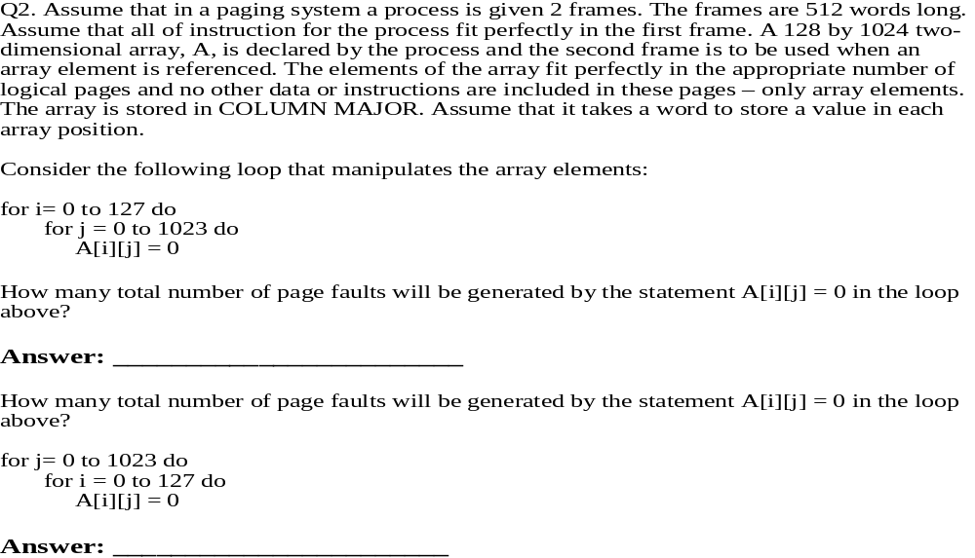
Questions

Slide 33
Questions for exam 2
Deadlocks
  Necessary conditions for deadlock
  Resource-Allocation graph
  Deadlock avoidance
  Deadlock prevention
  Banker’s algorithm
  Deadlock detection
  Wait-for graph
  Recovery from deadlock

Slide 34
Questions for exam 2
Main Memory
  Address binding
  Logical address space vs physical address space
  Memory allocation
    Dynamic storage allocation
    Strategies of selecting the free space
  Paging system
    The method of implementing paging system
    Effective access time
    Memory protection in a paging system
    Different structures of the page table
  Segmentation system
    Memory protection in segmentation systems
  Fragmentation in both systems
  Advantages of the paging system and segmentation system

Slide 35
Questions for exam 2
Virtual memory
  Benefits of virtual memory
  Demand paging
  Steps in handling a page fault
  Effective access time
  Copy-on-write
  Page replacement methods
  Second chance algorithm
  Allocation of frames
  Allocation algorithms
  Global vs local
  Thrashing
  Working-set model
  Prepaging
  Page size
  Program structure

Slide 36
End of Chapter 9

